Slide 1

ResidueFree Demo Lab
Logan Arkema and Micah Sherr*
Presentation will be posted at loganarkema.com/residuefree
*Co-Author on original paper

Slide 2
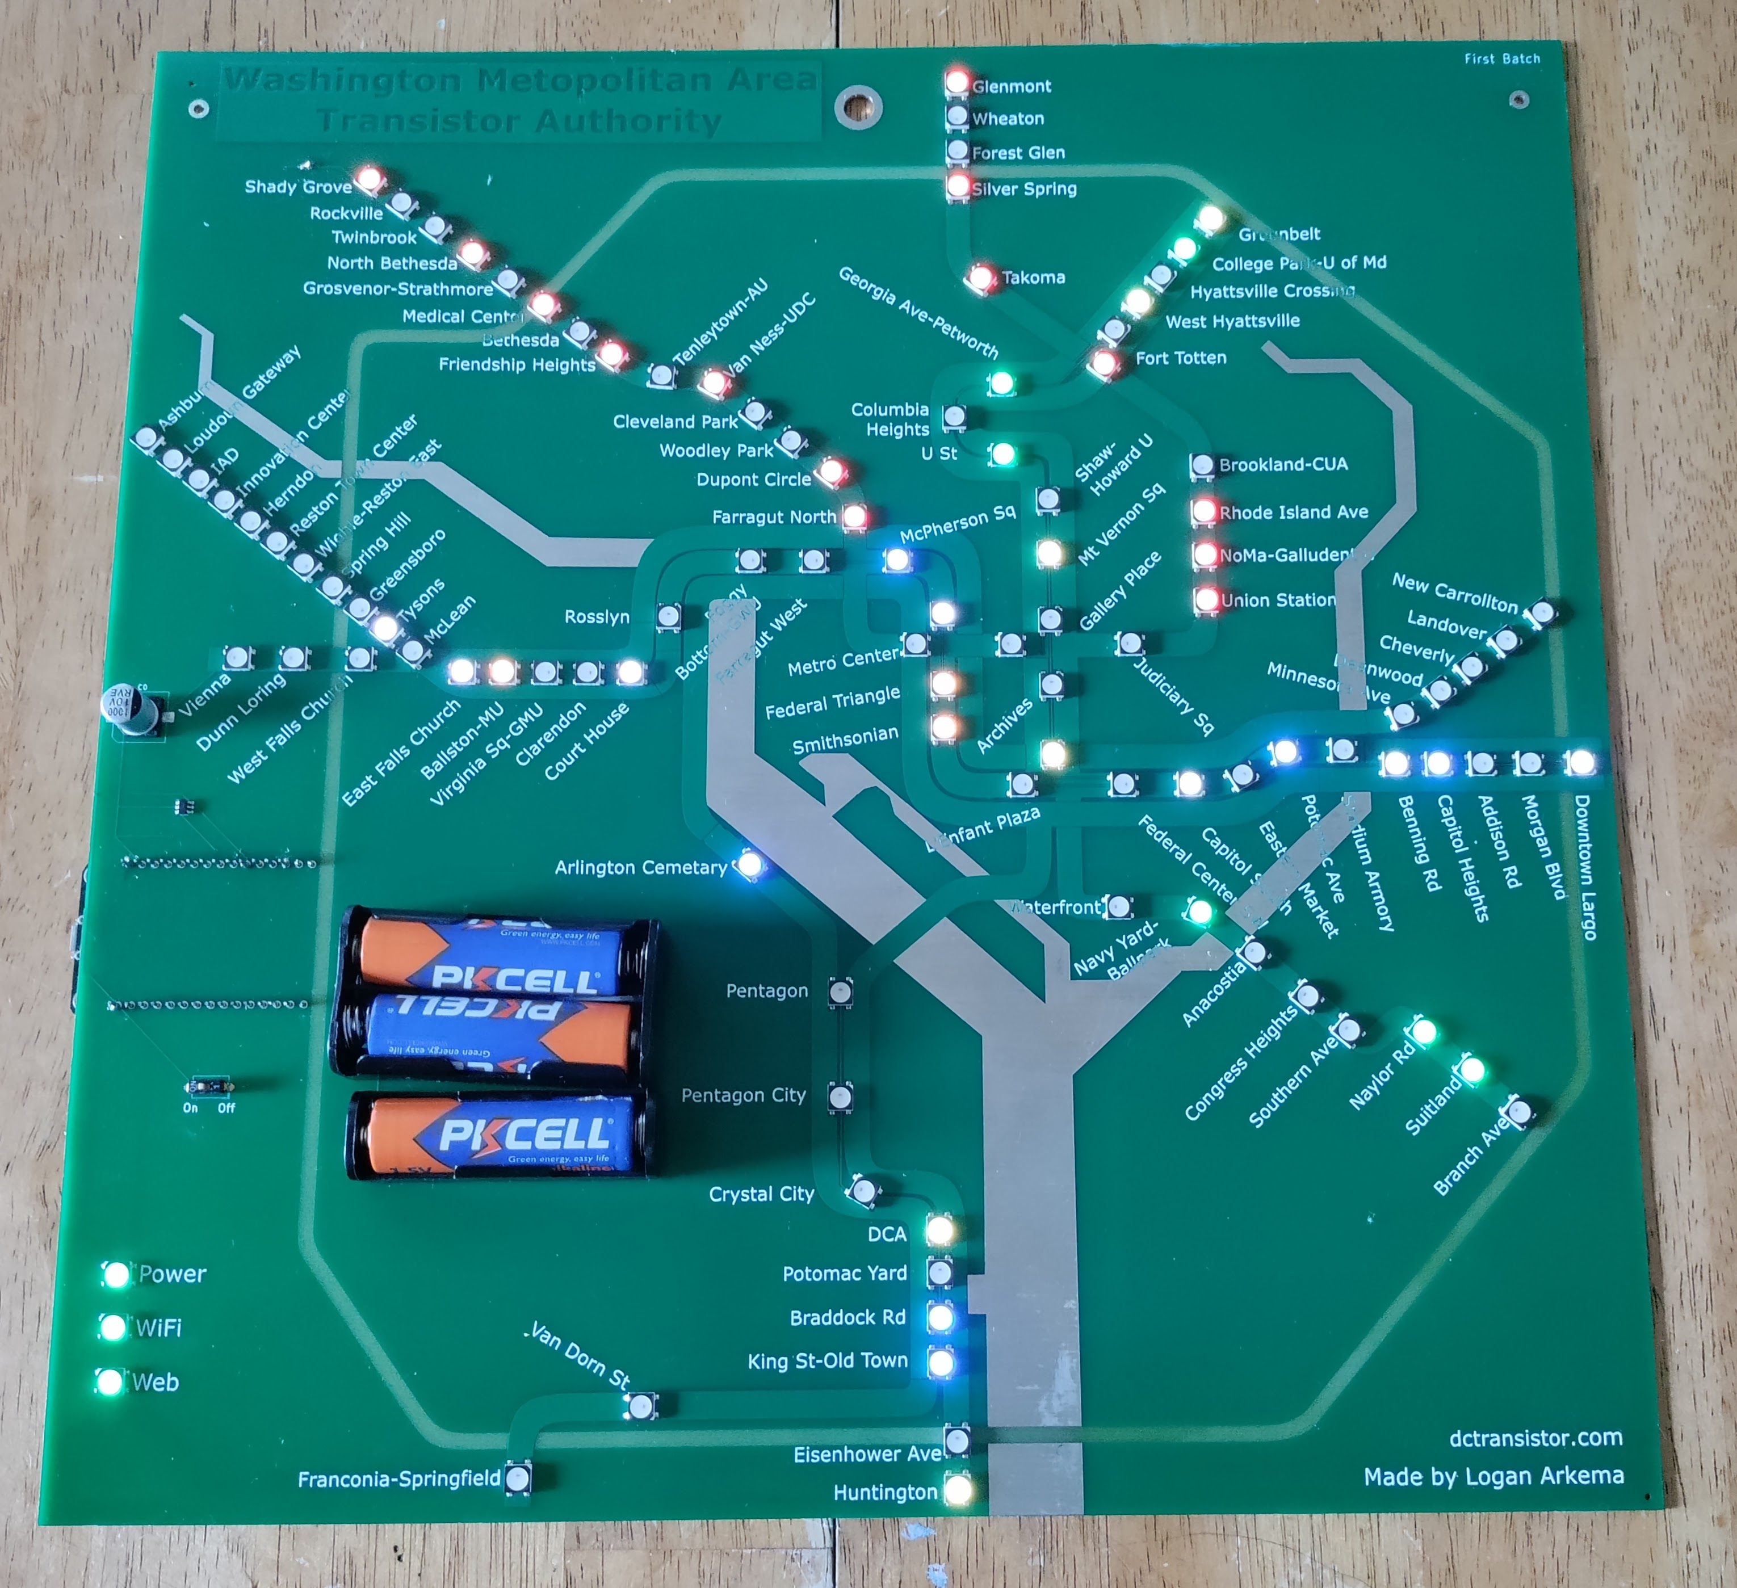
$whoami
Sr. Cybersecurity Specialist at $gov_agency*
Independent Researcher and Dev
Union Rep (#OrganizeYourWorkplace)
Maker of blinky boards of DC Metro system
Contact Info
@LoganArkema – loganarkema.com – OSINTable
*This presentation and project represent work I conducted while in college and during personal time. The opinions and views expressed in this presentation and the paper are my own and do not necessarily represent the thoughts, opinions, or positions of my current employer.

Slide 3
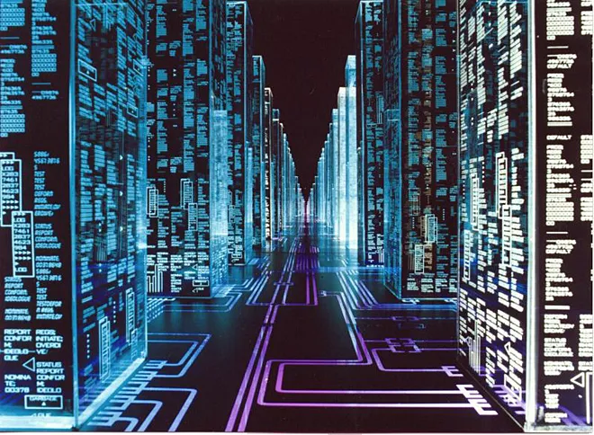

Privacy Today
Most privacy work is “server side”
An accurate threat model for most users most of the time

Slide 4
~coming (127.0.0.1 coming)
What about your machine?
Incentives for caching data
“Leave behind” sensitive information (residue)
User knowledge and consent?
Documents opened
App installs
Web sites and cache
Sensitive app use
Chat logs and timestamps

Slide 5



Enter ResidueFree
File changes from app execution

Slide 6
Architecture
Isolated Execution Environment
System Resources
All File Calls
User System
Union Filesystem
I/O
Network
Read-Write
Read-Only
CPU
RAM
User
Filesystem
Volatile
RAM Disk
Misc
System Procs
Residue-Free
Logical Operations
System processes with logging disabled
Private Residue-Free Session
Computer Hardware
Notes:
Which brings us to the high-level architecture for Residue-Free Computing. We begin with the user’s system, for our purposes mainly composed of the user’s filesystem, hardware resources, and system processes – some of which may need to be modified to ensure they don’t write sensitive information about Residue-Free to disk -, and the Residue-Free environment we want the user’s applications to run in. The key component of Residue-Free computing is volatile virtual disk in RAM. To prevent file carving or later recovery of sensitive residue, it is key that all file modifications occur in RAM and never touch the user’s physical disk. To mediate access between the user’s permanent filesystem and the RAM disk, we add a Union Filesystem – a logical filesystem that applications have direct access to, but that just directs file operations to the appropriate disk. Residue-Free applications must be able to Read and Write to the RAM filesystem, but only read from the user’s filesystem. The union filesystems should also be copy-on-write, so that any files modified inside Residue-Free are copied to the RAM disk, where they can again be read and re-written without additional calls to the User’s filesystem. Then, of course, we need to set up an execution environment where the applications run, and all file calls made inside that environment must go to the Union Filesystem. The final, and most challenging component, is providing the execution environment sufficient access to the user’s system resources – drivers, I/O, keyring, the user’s system configurations Inter-process communication – while minimizing the risk that these resources store information about what occurs inside Residue-Free. While doing this, we want to keep Residue-Free as lightweight as possible – an implementation could conceivably re-initialize may of these services inside Residue-Free, but that may cause interoperability problems, slow Residue-Free down, or –in technical terms – make the OS cranky. After Residue-Free exits, the implementation needs to ensure that all the residue in RAM is made inaccessible as quickly as possible.

Slide 7
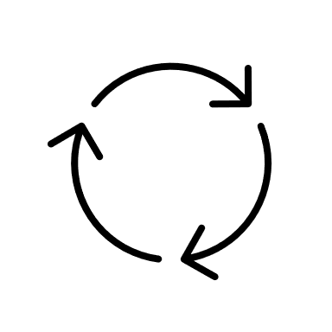



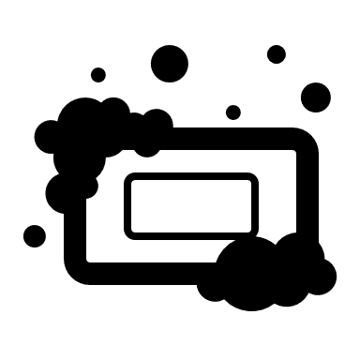
Implementation
.X11
pulse audio
unix sockets
network namespace
Podman Container
systemd*
System Resources
All File Calls
User System
unionfs
I/O
Network
Read-Write
Read-Only
ecryptfs
CPU
RAM
ext4
tmpfs
(noatime)
Misc
System Procs
ResidueFree
*limited services
log services
gnome trackers
Notes:
Which brings us to the high-level architecture for Residue-Free Computing. We begin with the user’s system, for our purposes mainly composed of the user’s filesystem, hardware resources, and system processes – some of which may need to be modified to ensure they don’t write sensitive information about Residue-Free to disk -, and the Residue-Free environment we want the user’s applications to run in. The key component of Residue-Free computing is volatile virtual disk in RAM. To prevent file carving or later recovery of sensitive residue, it is key that all file modifications occur in RAM and never touch the user’s physical disk. To mediate access between the user’s permanent filesystem and the RAM disk, we add a Union Filesystem – a logical filesystem that applications have direct access to, but that just directs file operations to the appropriate disk. Residue-Free applications must be able to Read and Write to the RAM filesystem, but only read from the user’s filesystem. The union filesystems should also be copy-on-write, so that any files modified inside Residue-Free are copied to the RAM disk, where they can again be read and re-written without additional calls to the User’s filesystem. Then, of course, we need to set up an execution environment where the applications run, and all file calls made inside that environment must go to the Union Filesystem. The final, and most challenging component, is providing the execution environment sufficient access to the user’s system resources – drivers, I/O, keyring, the user’s system configurations Inter-process communication – while minimizing the risk that these resources store information about what occurs inside Residue-Free. While doing this, we want to keep Residue-Free as lightweight as possible – an implementation could conceivably re-initialize may of these services inside Residue-Free, but that may cause interoperability problems, slow Residue-Free down, or –in technical terms – make the OS cranky. After Residue-Free exits, the implementation needs to ensure that all the residue in RAM is made inaccessible as quickly as possible.

Slide 8

Quick Notes
Privacy, not security, solution.
Has evolved from “proof of concept” c. 2021 -> “follow-up on proof” c. Monday
Does not eliminate evidence that ResidueFree ran

Slide 9
Usage
sudo ./residueFree.sh [-h] | -p [-s SIZE] [-o KEEP_DIR] | -f [-o OUTDIR] [-z] [-m] [-D]
-h show help text
Privacy Mode Options
-p select privacy mode - default (no file changes reach disk and are destroyed after use)
-s specify the size of the cache in RAM for changed files (default 1 Gigabyte - privacy mode only)
Accepts the same arguments as tmpfs(5) -o size=bytes
WARNING: Some arguments may cause programs to misfunction or corrupt RAM
-o specify which directory kept files are saved to
Forensic Mode Options
-f select forensic mode - privacy default (files changed are saved for analysis)
-o specify the directory where changed files are written to (default ./"residue_free_cache_<DATE_TIME>")
-z zip output files instead of leaving them in a directory tree structure
-m maintain empty root directories in saved cache output (deleted by default)
-D do not create diff file for all diffs between residue files and host system files"

Slide 10
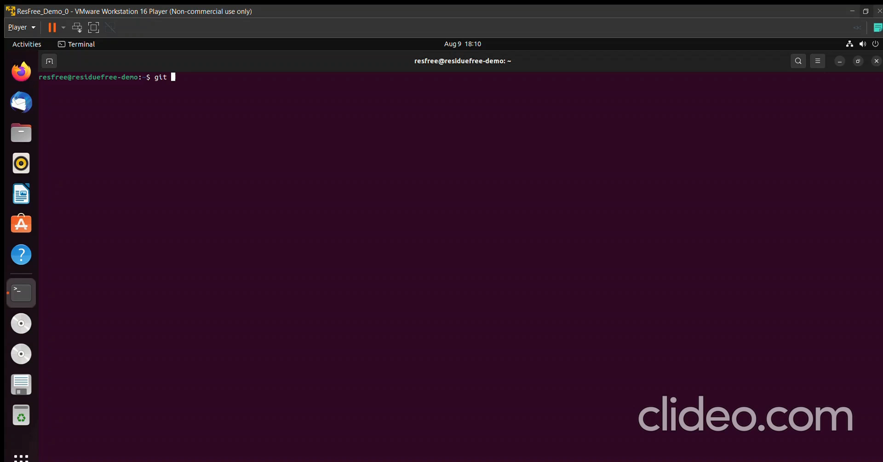

Slide 11
Limitations
Not All-Encompassing
Not every application or service runs in ResidueFree, and may vary by OS and version
Targeted at File System Artifacts, does not protect network or RAM by default. Risks of FS artifacts being picked up or recorded by system processes still exist.
Current implementation limited to Ubuntu (18-22)
Tradeoffs
Performance hits on File IO speeds
Usability and performance features vs. privacy protections

Slide 12
Contribute
Github: LArkema/ResidueFree
Small: bugs with different applications and better ways to implement features
Medium – Big: OS Ports
Contact
Twitter: @LoganArkema
ProtonMail: Logan [at] loganarkema [dot] com

Slide 13
Backup Slides

Slide 14
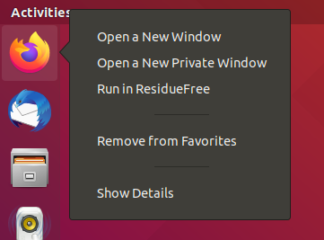
Application GUI Menu Option
GUI launch option for Desktop Applications
Launch option in right-click GUI menu
Designated folder for persistent files
Moved out of RAM before exit
Timestamps overwritten
Forensic Mode
Takes the file modifications that would have been destroyed and saves them in a designated directory
Bulleted Text Style Title— Helvetica Neue 20pt Bold

Slide 15


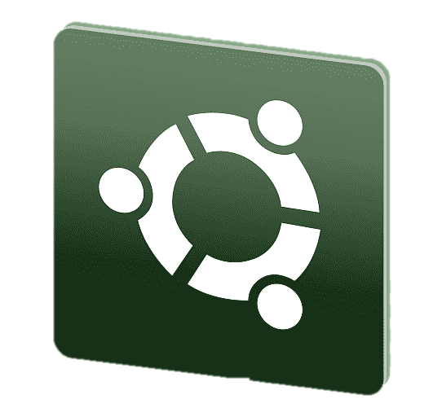








Sounds Neat, Does it Work?
1.
We compared the file systems of two VMs, which were identical up to the point that one ran ResidueFree while the other idled.
2.
Within ResidueFree we installed an app and used a VPN, document creators, multiple web browsers, messaging apps, and file transfer service – all trying to generate as much residue as possible.
3.
We then saved the state of each VM, created a hash for each file, and compared the files where the hashes differed (39 files).
None contained residue.

Slide 16
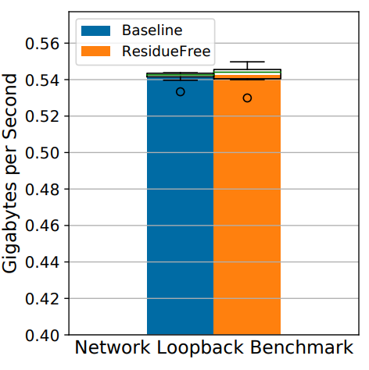
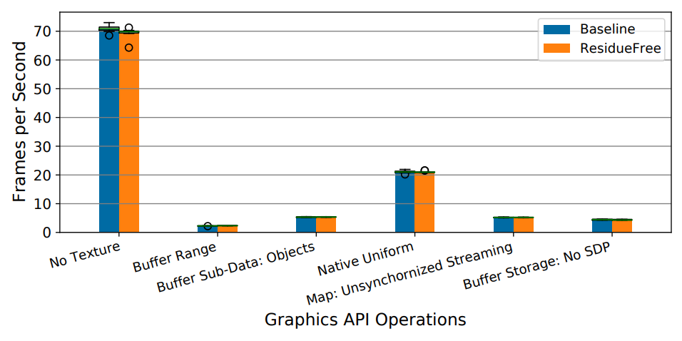
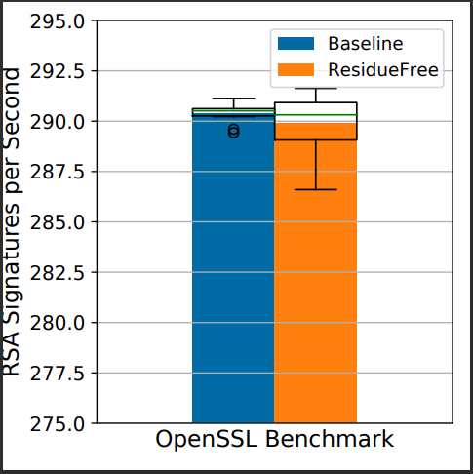
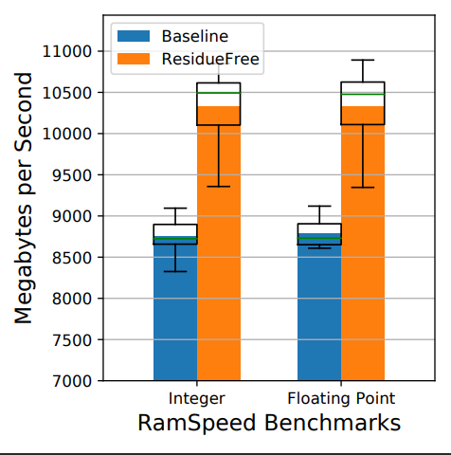
Great – Does it Work WELL?
Using various benchmarks from the Phoronix™ Benchmark Suite to measure computation, RAM, and network speeds – yes.

Slide 17
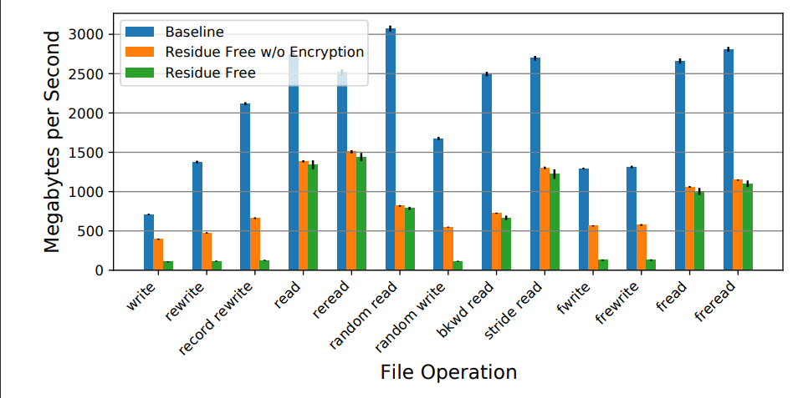
File Operation Hits
File operations, as measured by IOZone benchmarks, take a hit.

Slide 18
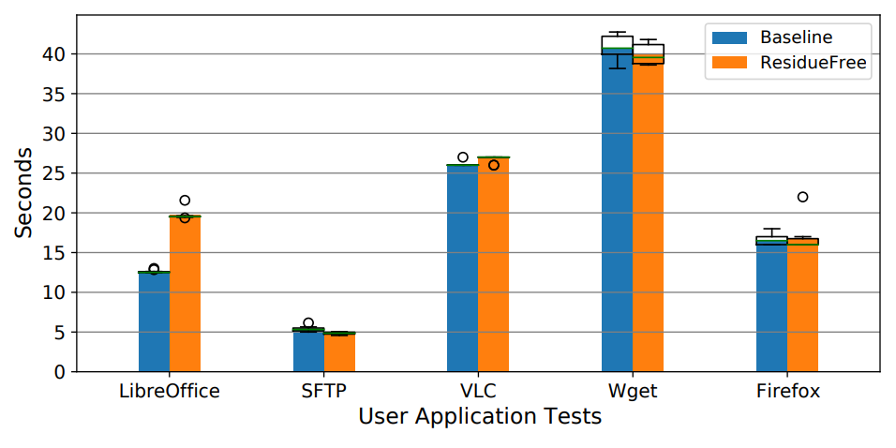
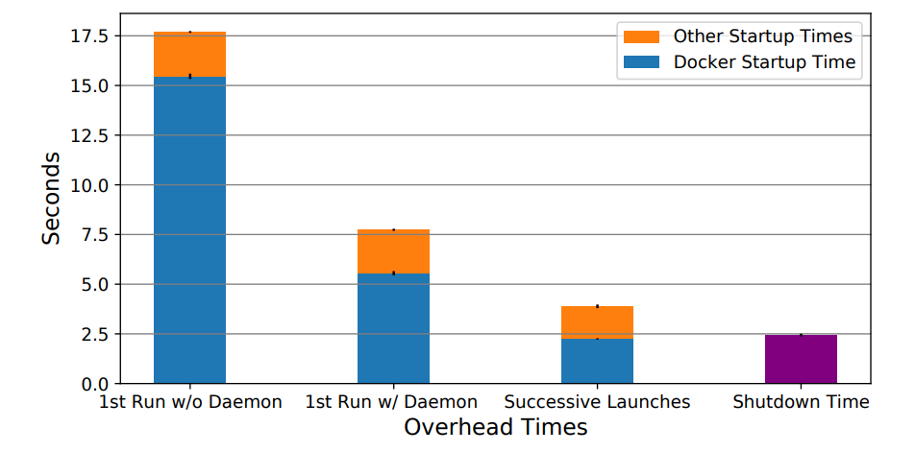
Application and Overhead Performance
Simple user application actions take negligible performance hits. Launch times, especially without the Docker Daemon (containerd) enabled, are noticeable - but these tests were run on a potato.

